Slide 1
Course: Engineering Chemistry Course Code: 107009
Unit I : Water Technology
By Arti Shinde
Dhole Patil College of Engineering

Slide 2
Course Objective:
To understand technology involved in analysis and improving quality of water as commodity.
Course outcome:
Apply the different methodologies for analysis of water and techniques involved in softening of water as commodity.

Slide 3
Contents:
Unit 1: Water Technology
Impurities in water
Hardness of water: types, units & numericals
Determination of Hardness (EDTA method using molarity concept), Alkalinity: Numericals
Ill effects of hard water in boiler- priming, foaming, boiler corrosion, scale & sludge, caustic embrittlement
Water Treatment: i) Zeolite method & numericals, ii) Demineralization method.
Purification of water: Reverse osmosis & Electrodialysis

Slide 4
Lecture Plan: Total Hrs:08Hrs
Lecture No. | Topic Covered
1 | Impurities in water, Hardness of water: types, units
2 | Hardness of water: Numericals, Determination of Hardness (EDTA method using molarity concept): procedure
3 | Determination of Hardness (EDTA method using molarity concept): procedure, Determination of Alkalinity: Procedure
4 | Determination of Alkalinity: Numericals, Ill effects of hard water in boiler- priming, foaming, boiler corrosion
5 | Ill effects of hard water in boiler- scale & sludge, caustic embrittlement. Water Treatment: i) Zeolite method : Procedure & reactions
6 | Zeolite method : Numericals, Water Treatment: ii) Demineralization method.
7 | Purification of water: Reverse osmosis & Electrodialysis
8 | Revision

Slide 5
Unit 1: Water Technology
Weightage : 15M
(only in In semester examination.)
Teaching Hours: 08 hrs.
Questions asked in ISE paper:
Q.1 a]5M, b] 4M, c]3M, d] 3M(Numerical)
OR
Q.2 a]5M, b] 4M, c]3M(Numerical), d] 3M(Numerical)

Slide 6
Imp in Engineering :
Steam generation
Coolant in power and, chemical plants
Production of steel, rayon, paper, atomic energy, textiles, chemicals, ice
Air conditioning etc.
Fire-fighting
In building and other concrete constructions
Agriculture

Slide 7
Sources of water
Surface water- sea, lake, river
Rain Water
Underground water- tube wells, well, spring
Types of Impurities in water
Suspended Impurities
Colloidal Impurities
Dissolved Impurities
Biological Impurities

Slide 8
Types of Impurities in water
Types of Impurities | Constituents | Size of the Constituent particles | Methods of removal
Suspended impurities | Clay, mud, organic matter | > 1000 Å | Filtration/ sedimentation / settlement
Colloidal impurities | Clay, mud, organic matter, | 10 to 1000 Å (negatively charge) | Coagulation followed by filtration. Coagulating agent Aluminium sulphate (alum) Al2(SO4)3, potash alum, KAl(SO4)2, sodium aluminate NaAlO2

Slide 9
Dissolved impurities | Dissolved gases like CO2, Cl2, H2S, SOx, NOx Dissolved salts like bicarbonates, sulphates, chlorides, nitrates of Ca, Mg, Fe, Al, Na, K etc. |  | By warming Chemical treatment
Biological impurities | Bacteria, algae, fungi, small size aquatic animals |  | Steralization Liquid chlorine, Ozone, Sodium hypochlorite, bleaching powder. UV light, Boiling of water

Slide 10

Soft water & Hard water
Hardness in the water is due to the presence of dissolved salts of heavy metal ions like Ca⁺², Mg⁺², Fe⁺², Mn⁺², Al⁺³ etc.
Major hardness is caused by Ca+2 and Mg+2 ions.

Slide 11
Hardness of Water
It is the characteristic of water which prevent lathering of soap.
OR
Hardness is the soap consuming capacity of water.

Slide 12
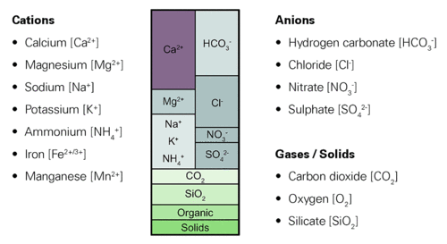
Salts dissociate in water and form ions: Positively-charged ions are designated as cations, and negatively-charged ions are anions. Water mainly contains different proportions of the following ions, depending on the source of the water:

Slide 13
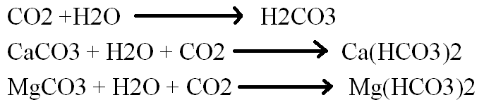

Causes of hardness
Dissolution of minerals
Na, Li, and K non hardness causing salts
Action of dissolved CO2
Action of O2

Slide 14
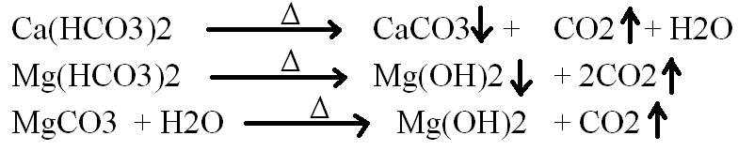
Hardness of water
Two types of hardness 1) Temporary hardness and 2) permanent Hardness
1)Temporary Hardness (Carbonate Hardness/ Alkaline Hardness ):
Hardness due to bicarbonates and some soluble carbonates is called temporary hardness. Salts Ca(HCO3)2, Mg(HCO3)2, MgCO3, FeCO3 are hardness causing.
Can be removed by boiling water.

Slide 15
Permanent Hardness (Non Carbonate/ Non Alkaline Hardness):
Hardness due to salts other than carbonates and bicaronates are called permanent hardness causing. Cannot be removed easily.
Due to chlorides, sulphates, and nitrates of Ca, Mg, Al, Mn, Fe.
i.e. CaCl2, MgCl2, CaSO4, MgSO4, Ca(NO3)2, Mg(NO3)2 etc.
Methods of removal- soda-lime, sodium phosphate, sodium aluminate, zeolite method, desalination method, RO, electrodylysis, ultrafiltration.

Slide 16
Carbonate hardness causing compounds | Noncarbonate hardness causing compounds
Calcium carbonate (CaCO₃) | Calcium sulfate (CaSO₄)
Magnesium carbonate (MgCO₃) | Magnesium sulfate (MgSO₄)
Calcium bicarbonate (Ca(HCO₃)₂) | Calcium chloride (CaCl₂)
Magnesium bicarbonate (Mg(HCO₃)₂) | Magnesium chloride (MgCl₂
Calcium hydroxide (Ca(OH)₂)
Magnesium hydroxide (Mg(OH)₂)

Slide 17
Hardness of water – is usually express in terms of equivalent amount of CaCO3
CaCO3 – is hardly soluble (most insoluble) in water
CaCO3 molecular weight = 100
CaCO3 equivalent weight = 50
Units of hardness
ppm – parts per million -1 part CaCO3 equivalent hardness in million parts (10⁶)of water
Milligram per litre: 1 mg CaCO3 equivalent hardness in 1 lit water .
1mg/lit = 1 ppm

Slide 18
Temporary Hardness | Permanent Hardness
1) Is due to bicarbonates and some soluble carbonates, e.g. Ca(HCO3)2, Mg(HCO3)2, MgCO3, FeCO3 | 1) Is due to chlorides, sulphates and nitrates of heavy metal ion , e.g. CaCl2, MgCl2, CaSO4, MgSO4, Ca(NO3)2, Mg(NO3)2
2) Can be removed by boiling the water | 2) Can be removed by chemical treatment
3) Also known as carbonate hardness or non alkaline hardness | 3) Also known as non carbonate hardness or non alkaline hardness

Slide 19


mg/lit CaCO3 equivalent hardness
ppm of CaCO3 equivalent hardness
For Monovalent salt
For bivalent salt

Slide 20
If 50 ml of water sample has 10 mg of CaCO3 equi. Hardness, the hardness of same water sample is ………
Ans – 200 mg/lit CaCO3 equiv.
2) CaCO3 equivalent of 10 % NaCl is ………
Ans- 0.8547 x 10⁵ ppm of CaCO3 equiv.
3) 5.85 gm of NaCl has CaCO3 equivalnce ………..
Ans- 5 x 10³ ppm of CaCO3 equiv.
4) A water sample containing 16.2 mg of Ca(HCO3)2; 36mg of MgSO4; 27.2 mg CaSO4; 2 mg MgCO3; Find the temporary, permanent and total hardness. (Equi. Wt Ca(HCO3)2= 81; MgSO4 = 60; CaSO4 = 68; MgCO3 = 42)

Slide 21
Mol. Wt. H=1; C=12; N = 14; O=16; Na= 23 Ca= 40; Mg= 24; S=32; Cl= 35.5
Calculate the temporary, permanent and total hardness of a water sample having the following analysis
Mg(HCO3)2 = 73 mg/l
Ca(HCO3)2 = 162 mg/l
CaSO4 = 136 mg/l
MgCl2 = 95 mg/l
CaCl2 = 111 mg/l
NaCl = 100 mg/l

Slide 22

W – mg of CaCO3 equivalent of salt per lit
ppm → weight by weight (mg/kg)
→ weight by volume (mg/lit)
1 mg/lit means 1 mg CaCO3 equivalent of salt in 1 lit
1 milligram per litre = 1 ppm
1 x 10³ microgram(μg) per litre = 1ppm
0.001 gram per litre = 1 ppm

Slide 23
Hardness rating | Concentration of Calcium Carbonate (mg/L)
Soft | 0 to <75
Medium hard | 75 to <150
Hard | 150 to <300
Very hard | 300 and greater
Municipal supply/ drinking water = 150-250 ppm
Dye industry, paper industry, sugar industry, textile mill = 0-50 ppm
Bakery and food processing = 150-250 ppm
High pressure boilers and pharmaceutical industries 0-10 ppm of CaCO3 Equivalence

Slide 24
Determination of Hardness by EDTA method
Complexometric method
All types of hardness in water can be removed
Rapid estimation of hardness
More accurate results
Very convenient method

Slide 25
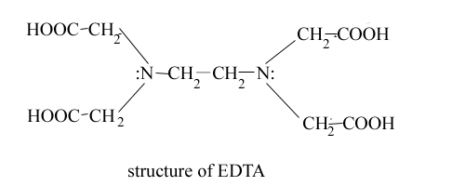
Determination of Hardness by EDTA method
EDTA- Ethylene diamine tetra acetic acid
EDTA – readily forms stable complex with heavy metal ions at particular pH
EDTA – sparingly soluble salt , therefore disodium salt of EDTA is used (Na2EDTA)- soluble
EDTA is a hexadentated ligand

Slide 26
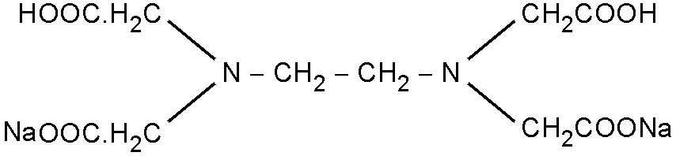
Na2EDTA Structure
Suitable pH is required for the reaction to complete between metal ions present in water and Na2EDTA otherwise reaction is reversible, no complex formation
During reaction H+ ions are forming and decreases the pH of reaction mixture
10 pH buffer solution is added ( 10 pH buffer solution – NH4Cl + NH4OH)
Complexometric titration
EBT – eriochrome black T indicator

Slide 27
Calcium and magnesium ions form 1:1 complexes with EDTA according to the equations:
Ca²⁺ + H₂EDTA²⁻ → CaEDTA²⁻ + 2H⁺
Mg²⁺ + H₂EDTA²⁻ → MgEDTA²⁻ + 2H⁺
The indicators used are Eriochrome Black T which changes from red to blue in the presence of excess EDTA.
CaIn⁻(pink-red) + H₂EDTA²⁻ → CaEDTA²⁻ + HIn²⁻(blue) + H⁺

Slide 28
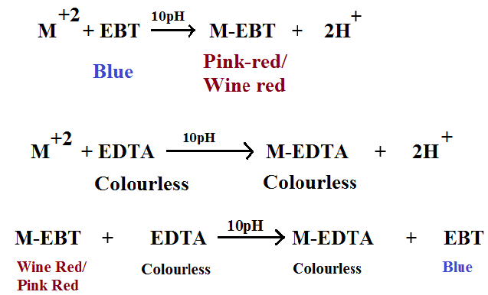
Reactions
Eriochrome Black-T indicator is used in this titration. When it is chealted or acidifies, it produces a Wine Red /Pink Red solution. When it is not chelated and under basic conditions it is Blue.

Slide 29


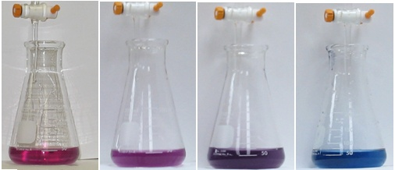
Procedure
I: Standardization of EDTA by using Std. ZnSO4 solution
EDTA = ZnSO4
M1V1= M2V2
II: Hardness of water sample.
Hardness of water =
y – volume of Na2EDTA
V – volume of water sample titrated
Z – molarity of Na2EDTA

Slide 30
Calculation :
1 ml 1M Na2EDTA = 40 mg Ca+2 = 24 mg Mg+2 = 65.4 mg Zn+2
Hardness of water =
Temporary and Permanent Hardness by EDTA
By using this EDTA method total hardness of given water is found out.
Total Hardness = Temporary Hardness +Permanent Hardness
Then hardness of boiled and filtered water sample is found out . Boiled and filtered water contains only permanent hardness.
Knowing Total and permanent Hardness Temporary Hardness can be calculated.
Temporary Hardness = Total Hardness – Permanent Hardness

Slide 31
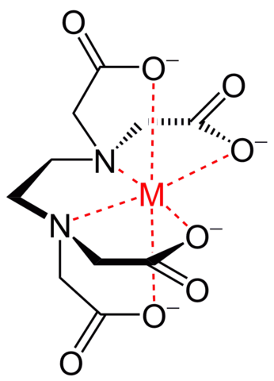
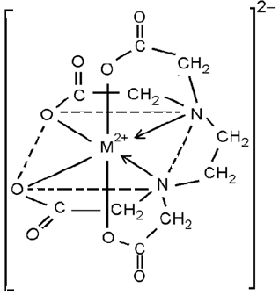
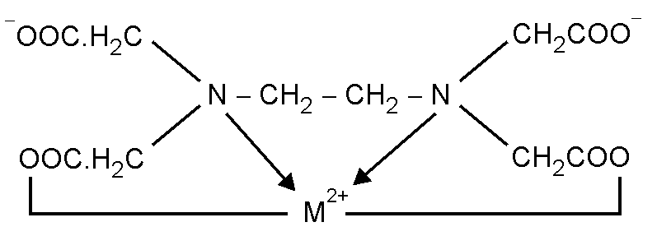
M- EDTA Complex structure

Slide 32
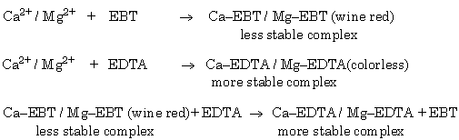
Advantages of EDTA method
Suitable indicator is available for accurate reading
Sharp change colour at the end point of titration (pink red to blue)
Method is useful for low concentration of metal ions also and gives accurate results
EDTA method is convenient , fast, easy.

Slide 33
Consider V ml of water sample taken of titration required y ml Z M EDTA
1 mole of EDTA = 1 mole CaCO3
1000 ml 1M EDTA = 100 gm CaCO3
1 ml 1M EDTA = 100 gm / 1000ml = (100 x 1000)/ 1000
= 100 mg CaCO3
y ml Z M EDTA = y x Z x 100 mg CaCO3
V ml hard water contains = y x Z x 100 mg CaCO3
1000 ml hard water
Contains =

Slide 34
Ca⁺² +EDTA →Ca- EDTA
1 ml 1M Na2EDTA = 40 mg Ca+2 = 24 mg Mg+2 = 65.4 mg Zn+2
1 mole of CaCO₃ = 1 mole EDTA
i.e. 100 g CaCO₃ = 1 mole EDTA
Now,
1000 ml 1 M EDTA = 100 g CaCO₃
1000 ml 1M EDTA = 40 gm Ca⁺²
1 ml 1M EDTA = 40/1000 gm of Ca⁺²
1ml 1M EDTA = (40 x 1000)/ 1000 mg Ca⁺²
1 ml 1M EDTA = 40 mg Ca⁺²

Slide 35
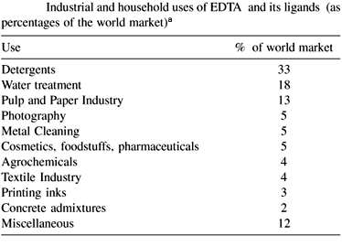

Slide 36
1) 50 ml of a water sample requires 1.7 ml of 0.02M EDTA during titration. Calculate total hardness of the water
2) The given Ca⁺² ion solution is diluted to 250ml volume with distilled water . 25 ml of this diluted solution when titrated with 0.02M EDTA solution required 18.3 ml for the end point calculate the amount of Ca⁺² ion present in the given solution. (Ans. 146.4 mgCa⁺² ion)
3) 50 ml sample water containing Mg salts, when titrated with 0.05 M EDTA requires 41.5 ml for the end point calculate the amount of Mg ions present per litre of the sample water.

Slide 37
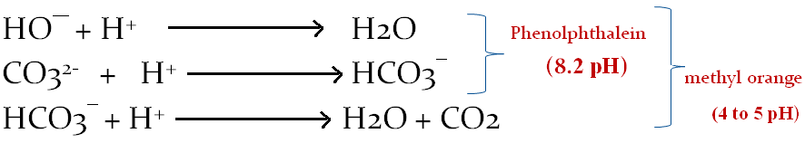
Alkalinity of water
Alkalinity is the acid neutralizing capacity of water.
Alkalinity is due to the presence of -
Hydroxides: NH4OH, NaOH, Ca(OH)2
Carbonates: MgCO3, FeCO3, Na2CO3
Bicarbonates: Ca(HCO3)2, Mg(HCO3)2, Fe(HCO3)2, NaHCO3
Reactions:

Slide 38
Types of alkalinity
Only HO¯
Only CO₃⁻²
Only HCO₃¯
HO¯ and CO3⁻² together
CO₃⁻² and HCO3¯ together
HO¯ , CO₃⁻² and HCO3¯ or HO¯ and HCO3¯ could not exist together because
HO¯ + HCO3¯ → H2O + CO₃⁻²

Slide 39
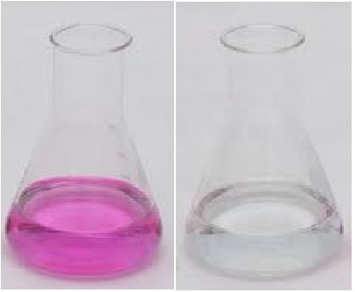
Procedure:
Part I
1) Fill burette with standard acid solution (HCl)
2) Take 10 ml alkaline water sample in conical flask.
3) Add 2-3 drops of Phenolphthalein Indicator.
4) Titrate this solution with standard acid solution End point. End point is Pink to colourless.
5) Note the burette reading as V1 ml.

Slide 40
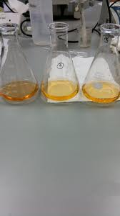
Part II
1) Take solution from part I.
2) Add 2-3 drops of Methyl orange Indicator in the solution from part I.
3) Continue the titrate from V1 ml Std HCl solution.
4) End point of titration is yellow to orange
5) Note the burette readingas V2 ml.
In an acid, it is reddish and in alkali, it is yellow. Methyl orange
Methyl orange (pH indicator)
below pH 3.1 |  | above pH 4.4
3.1 | ⇌ | 4.4

Slide 41
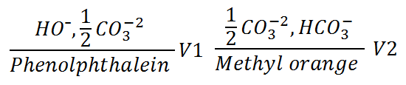

Calculation

Slide 42
Calculations:
1ml 1N HCl = 50 mg CaCO3
Relation between P and M | HO¯ Alkalinity | CO3²⁻ Alkalinity | HCO3⁻ Alkalinity
P=0 | 0 | 0 | M
P=M | P | 0 | 0
P=1/2M | 0 | 2P | 0
P>1/2 M | 2P-M | 2(M-P) | 0
P<1/2M | 0 | 2P | M-2P

Slide 43

CaCO3 + 2HCl → CaCl2 +H2O +CO2
Consider V ml of alkaline water sample taken for titration required V1 ml Z M HCl
1 mole of HCl = ½ mole CaCO3
1000 ml 1M HCl = 50 gm CaCO3
1 ml 1M HCl = 50 gm / 1000ml = (50 x 1000)/ 1000
= 50 mg CaCO3
V1 ml Z M HCl = V1 x Z x 50 mg CaCO3
V ml alkaline water contains = V1 x Z x 50 mg CaCO3
1000 ml alkaline water
Contains =

Slide 44
Boiler
Boiler or steam boiler
–is an essential part of Thermal Power Plant
A boiler is a device for generating steam which consists of two parts-1) Furnace 2)Boiler
Furnace – which provides heat usually by burning a fuel
Boiler- a device in which the heat changes water into steam
Types of Boiler- 1) Water tube boiler
2) Fire Tube Boiler

Slide 45
Boiler Feed water
Steam generation and coolant
Ill/ Bad Effects of Hard Water in Boiler
Corrosion
Priming & Foaming
Scales & Sludge
Caustic embrittlement
Water with minimum hardness and maximum purity
is good for boiler feed
Type of boiler Steam Pressure | Permitted Hardness of Boiler Feed water
Low pressure Below 15 kg/ cm2 | 25- 50 ppm of CaCO3 equiv.
Medium pressure 15-30 kg/ cm2 | 10 - 25 ppm of CaCO3 equiv.
High pressure Greater than 30 kg/ cm2 | 0 - 10 ppm of CaCO3 equiv.

Slide 46
1. Priming & Foaming
Priming (Carry over): Wet Steam formation
Vigorous boiling of water leads to formation of wet steam is known as priming.
Causes:
Presence of suspended impurities in water.
Very high level of boiler feed water
High steam velocities/ Sudden steam demands.
Improper boiler design
Sudden increase in steaming rate.
Prevention:
Fitting mechanical steam purifiers
Avoiding rapid change in steaming rate
Maintaining low water levels in boilers
Efficient softening and filtration

Slide 47
Foaming:
Production of persistent foam or bubbles on the surface of boiler feed water is known as foaming .
Causes
Presence of substances like oils, soaps which reduces surface tension of water.
Prevention:
Adding antifoaming chemicals like castor oil.
Removing oil impurities by adding compounds like Na-aluminate and blow down operation at appropriate time.
Na- aluminate – NaAlO2, NaAl(OH)4 hydrated, Na2Al2O4.

Slide 48
Disadvantages of Priming & Foaming
Wet steam carries dissolved salts which get deposited on turbines blades .
Decreases life of machinery
Height of water column cannot be judged .
Reduces the efficiency of machine parts and to some extent their corrosion
Foaming cause wet steam formation.

Slide 49
2. Scale and Sludge Formation
Sludge: Loose & slimy Precipitate/ deposit
Formed at comparatively cooler portions of boiler
Causes:
Salts with greater solubility in hot water than in cold water . eg. MgCO3, MgCl2, CaCl2, MgSO4
Disadvantages
waste some portion of heat
Excessive sludge formation disturbs working of boiler and some times may choke up the pipe.
Sludge reduces rate of flow of water in boiler.
Prevention of sludge formation
By using soft water
By frequent blow down operations followed by ‘make up’ water.

Slide 50
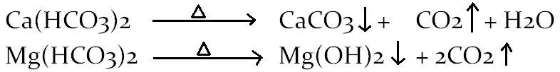
Scales
Scales are Hard, adherent, precipitate
Causes- four causes are there for scale formation
1) Decomposition of bicarbonates- into scale forming precipitate
2) Decrease in solubility of CaSO4
CaSO4 has lesser solubility at high temperature
Almost insoluble in super heated water in high pressure boilers.
Temperature / °C | Solubility of CaSO4
15 °C | 3200 ppm
230 °C | 55 ppm
320 °C | 27 ppm

Slide 51
Causes of Scale formation
3) Hydrolysis of Magnesium salts
At higher temperature, magnisum salts undergo hydrolysis, to form sticky magnesium hydroxide solid particles. And also the chain reaction of acid formation starts.
4) Presence of silica:
forms CaSiO3, MgSiO3. these silicate deposits stick very firmly on inner walls of the boiler surface and are very difficult to remove.

Slide 52
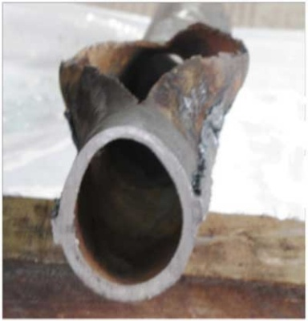
Disadvantages of Scale formation
Wastage fuel –Scales are bad conductors of heat, 0.25 cm scale increases fuel consumption by about of 2 to 3 times
Over heating of boiler -
Lowering of boiler safety
Decrease in efficiency
Danger of explosion

Slide 53
Removal of scale
By scraper or piece of wood or wire brush
EDTA treatment
Soft scales can be removed by blow down operation.
Hard scales can be removed by giving thermal shocks.

Slide 54
Sludge | Scale
1) Sludge are loose & slimy precipitate | 1) Scales are hard, sticky deposit
2) Less adherent and can be remove easily by brushes, detergents | 2) Strongly adhered on boiler metal & difficult to remove
3) Formed on cooler parts of boiler. | 3) Scales formed on hot parts of boiler
4) Sludge are formed due to an increase in concentration of salts, MgCO3, MgCl2, CaCl2 | 4) Scales are formed due to CaSO4, CaCO3, Mg(OH)2, MgSiO3, CaSiO3, SiO2 etc
5) Can be removed by blow down operation. | 5) Can be removed by EDTA treatment.
6)Heat transfer to boiler water is affected slightly . | 6) Scales being bad conductor of heat transfer to boiler water is affected largely.

Slide 55
Boiler Feed Water Treatment
Internal Treatment
Calgon conditioning-
Colloidal conditioning
Phosphate conditioning
External Treatment
Zeolite process
Ion exchange method/ de-onisation

Slide 56
External Treatment: Zeolite Process/ Permutit Process
Zeolites are the complex mixture of metal aluminate and metal silicates ,
formula is Na2O.Al2O3.xSiO2.yH2O
where x = 2 to 10 and y = 2 to 6
General Formula Sodium zeolite - Na2Ze
Zeolite can be considered as a special crystalline solid having a characteristic framework structure with cavities occupied by ions and water molecules that have considerable freedom of movement.
This Process is also known as Permutit Process or Cation exchange method.

Slide 57
Zeolites are of two types:
1. Natural Zeolites: Derived from natural sources like green sand and Nonporous more durable Example Natrolite
2. Synthetic or Artificial Zeolite: Prepared in laboratory and porous. Posses a gel like structure, more efficient so common in use Prepared by heating China clay, Feldspar, and Soda.

Slide 58
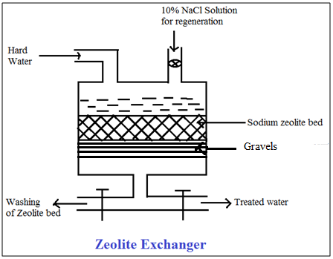
Zeolite
Principle - Sodium zeolite has the property of capturing the heavy metal ions (Ca+2 ; Mg+2 etc) from water, in exchange with release Na+ ions. Due to removal of heavy metal ions from water , the hard water is converted into soft water by zeolite. Zeolite process is also known as Permutit process.

Slide 59
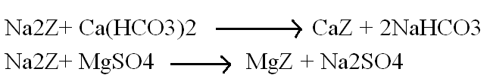
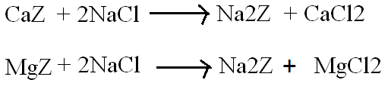
Zeolite Process
Softening Reaction
Regenaration of Exhausted Zeolite : 10% NaCl
Advantages:
Hardness is completely removed
Compact equipment, occupies less space
No precipitation of impurities, no danger of sludge formation
Clean process
Requires less time, Easy process, Low cost
Water obtained has hardness 5-10 ppm

Slide 60
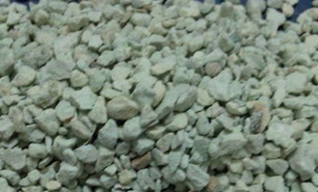
Applications of Zeolite Process
For removing hardness causing ions
To remove toxic metal ions and dye cations
To recover valuable trace metals from industrial waste
Small scale treatment
Green zeolite stones

Slide 61
Limitations of Zeolite method
Water containing turbidity/collidal impurities should not be soften by zeolite softener, turbidity will block the pores on Zeolite.
Warm water should not be soften as it may decompose sodium zeolite.
Hardness of water obtained has hardness 5-10 ppm but contain equivalent amount of Na ions.
Water containing Mn+2 and Fe+2 should not be soften by using zeolite softener as forms corresponding zeolite MnZ and FeZ , regeneration of these zeolite will not be possible.
Method is applicable for a small scale treatment.

Slide 62


Zeolite Numerical
Steps to solve
1) Amount of NaCl in mg/lit= Lit of NaCl X g of NaCl X 1000
2) Amount of NaCl as CaCO3 equivalent
3)

Slide 63
1) An exhausted zeolite was regenerated by 150 litres of NaClhaving strength 150 gm/lit. How many litres of a hard water having hardness 400 ppm as CaCO3 can be soften by this softener? (Ans – 48075 litres)
2) A zeolite bed exhausted by softening 4000 litres of water sample, requires 10 litres of 15% NaCl solution for regeneration. Calculate the hardness of the water sample. (Ans- 320.51 ppm of CaCO3 equivalent)

Slide 64
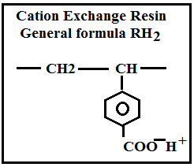
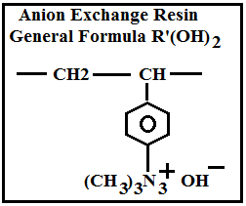
Ion Exchange Process
For this process ion exchange resins are used as softener
Removes both–cations & anions
Ion exchange resins are insoluble crosslinked long chain organic polymers with microporous structure and ‘functional groups’ attached to the chain are responsible for the ion-exchanging properties.
Cation exchanger – general formula RH
Anion Exchanger - general formula R(OH)

Slide 65
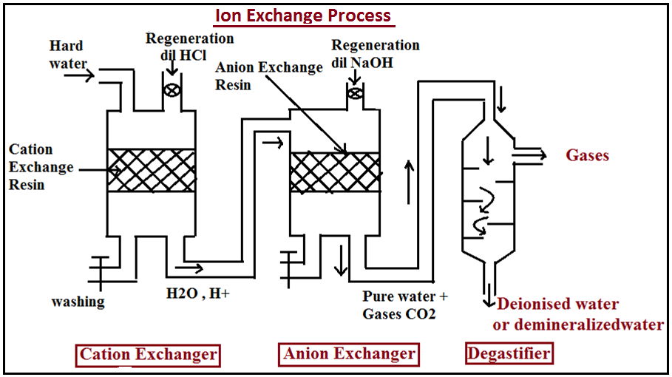
Principle of Ion exchange method- When water containing cations and anions is passed through resins, cation exchanger resins captures all cations (in exchange of H⁺) and anion exchanger resins captures all anions (in exchange of OH⁻) to give pure and all ion free water.

Slide 66


Reactions
When water enters cation exchanger - cations present in water get exchange with H+ ions
Then water enters anion exchanger-anions present in water get exchagnge with OH- ions

Slide 67

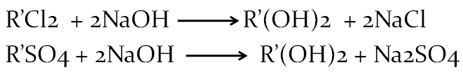
Regeneration Reactions
Cation exchanger- exhausted cation exchanger resin is regenerated by washing with dil HCl
Anion Exchanger- exhausted anion exchanger resin is regenerated by washing with dil NaOH
Advantages:
Produces water with 0 to 2 ppm hardness which is very low, soft water obtained can be used for high pressure boiler
Process can be used for highly acidic or alkaline water sample.

Slide 68
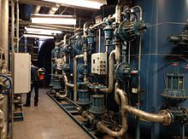
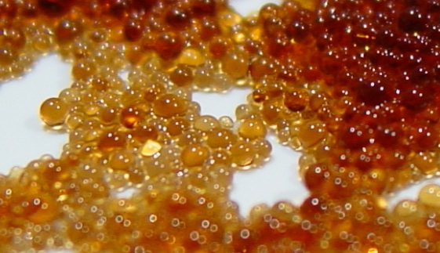
Limitations of Ion exchange method
High initial investment/ equipment used is costly.
Chemicals used are expensive
can not be used for turbid solution.
Ion exchange resin beads
Large cation/anion ion exchanger used for purification of boiler feed water

Slide 69
Desalination of Brackish water
Fresh water– TDS below 500 ppm
Sea water– TDS about 35,000 ppm
Brackish water– TDS about 10,000 ppm
The process of removing salts from sea water or brackish water to make it suitable for domestic, industrial or irrigation purposes is called desalination.
Methods of Desalination
Membrane process
A) Electrodialysis
B) Reverse osmosis

Slide 70
Desalination of Brackish water
Desalination is the process of removing common salt (mostly NaCl) from water.
Electrodialysis
The process of removing ionic pollutants (salts, ionic dyes) from water by using membranes and electric field is known as electrodialysis.
Salts in water – cations and anions
ED is an electro-membrane process in which ions are transported though ion permeable membrane from one solution to another under the influence of a potential gradient.

Slide 71
Construction and working
An electrodialysis unit consists of a large number of paired sets of plastic membranes
– these membranes are ion selective
Cation selective membrane– contains group of –SO3⁻² , -COO⁻
Anion selective membrane– contains group of –NR3⁺ , C5H5N⁺R
When an electric field is applied perpendicular to the direction of flow of water, anion move towards positively charged electrode through anion selective membrane
Similarly cation move towards negatively charged electrode through cation selective membrane
Alternate chambers of pure water

Slide 72
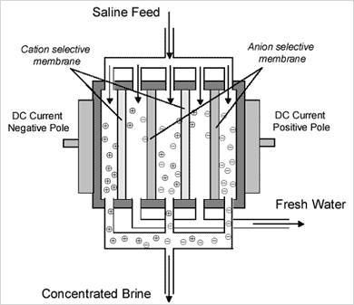

Slide 73
Applications –
Removal of ionic pollutants from treated industrial waste
Removal of salts from sea water to get pue water
Removal of limited quantity of salts from sea water to get drinking water (mineral water)
Desalination of contaminated industrial water for reuse.
Recover of salts from salt concentrated water.
Limitations of Electro-dialysis:
Organic matter (non-ionic matter) cannot be removed.
Colloidal matter SiO2 cannot be removed.
Membranes require maintenance.

Slide 74
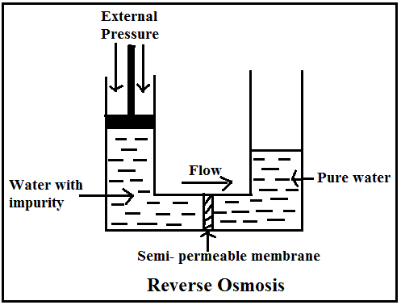
Reverse Osmosis (RO) - In RO solvent flows from higher concentration solution to lower concentration solution applying external pressure on the higher concentration solution slightly higher than its osmotic pressure.
In RO pure water can be separated from contaminated water rather than contaminant from water.

Slide 75
Process:
In this process, pressure of 15-40 kg/cm2 is applied to the sea water /impure water to be treated to force pure water out through semipermeable membrane leaving behind ionic and non-ionic impurities.
Semipermeable membranes based on thin films of cellulose acetate, polymethyl acrylate, polyamide polymers are used.
Advantages of RO:
RO is capable of removing dissolved salts as well as organic substances along with bacteria and viruses present in water.
This process is simple and requires few minutes.
It convert sea water to drinking water at low cost.
It removes colloidal silica which is not removed by demineralization.

Slide 76
Limitations:
Water obtained by RO is not potable water. To get potable water specially design semipermeable membrane is used which allows permitted quantity of salts.
Bacteria and virus having size smaller than the pore size of membrane are not removed from water.
Taste of potable water obtained from RO process is affected as natural minerals are removed.
RO membrane is subjected to decay and require periodic replacement.
Applications:
RO all ionic, colloidal, nonionic pollutants
Simple to operate
Low cost process
Pure water for high pressure boiler can be obtained
Drinking mineral water

Slide 77
Atmospheric water generator
The atmosphere contains water in the form of water vapour ,moisture etc…
Dehumidification and hvac (heating , ventilation and airconditioning) techniques are used to extract water from the atmospheric air.
The device uses the principle of latent heat to convert watervapour molecules present in the atmospheric air into waterdroplets.
An atmospheric water generator (AWG) is a device that extracts water from humid ambient air, producing potable water. Water vapor in the air can be extracted by multiple techniques, including condensation-1) Cooling the air below its dew point 2) Heat exchange tech. 3)Exposing the air to desiccants

Slide 78
1) Using Dew point The temperature at which the water vapor in the air reaches a maximum saturation without the influence of an external pressure source is referred to as the atmospheric dew point. Td = T - ((100 - RH)/5.) where Td is dew point temperature (in degrees Celsius), T is observed temperature (in degrees Celsius), RH is relative humidity (in percent). Apparently this relationship is fairly accurate for relative humidity values above 50%.

Slide 79
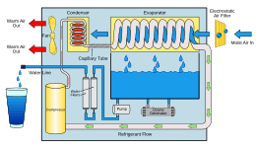
Working of AWG
principle of AWG is based on the Dehumidifier to extract water from moist air. The best condition is when the humidity at least over 70% .
Dehumidifier sucks in air from one end, by using fan.
Surrounding air cooled by evaporating coil .
Then surrounding air is cooled by an evaporator coil. takes the moisture out of it by condensation.
Then dried air blows it back out again.
The resulting water is then passed into a holding tank with purification and filtration system to keep the water pure.

Slide 80
Advantages
1.Clean and pure can be obtained due to processes of multi filtration.
2.Eliminates hazards caused by viruses, bacteria, pesticides and heavy metal contaminants.
3.Rich oxygen contained in the water improves metabolism of your body.
4.Tastes sweeter and better.
5.Once connected to the power supply, it can supply hot & cold.
Disadvantages
1.The product price of an AWG is higher compared to municipal.
2.AWGs face a challenge with sandy areas such as deserts
3.Climate is an important factor for AWG machines to run efficiently.
FUTURE SCOPES
1.Atmospheric water generation technology's entrance into the commercial market is mainly to offer a solution to the worsening global water crisis.
2. May be in next 5 to 10 years Atmospheric Water Generators can be used instead of water purifiers.

